Slide 1
Weather Prediction Web Application
Akanksha Pradeep Chavan 250243120006
Mayuri Rajendra Patil 250243120031
Mrunal Rajendra Desai 250243120033
Infoway Technologies Pvt. Ltd,Pune
CDAC PG-DAC

Slide 2
Introduction
Weather Forecast is a user-friendly weather forecasting application that provides real-time weather updates. The application uses has interactive and responsive user interface.
Offers 7-days advance weather forecast, enabling users to plan activities accordingly.

Slide 3
Key Features
Real-Time Weather Data
Weekly Forecast
Weather Highlights
Application will retrieve real-time weather data for the city entered.
A 7-day forecast will be provided using OpenWeather API.
Includes Wind-Speed, Pressure, Sunrise/Sunset time, Humidity.

Slide 4
Project Objectives
User-Friendly Interface
Develop a web-based weather application
Advance Weather Forecast
API Integration

Slide 5
Technology used
Frontend
HTML5, CSS3, JavaScript, React used for structuring and styling the web page.
OpenWeather API and JWT authentication
API provides real-time weather data like temperature, humidity, and pressure, while JWT ensures secure, authenticated access to this data in web applications.
Responsive Web Design
Improving user experience across devices(various screen size).

Slide 6
Design and User Interface (UI)
Temperature
Humidity
Air Pressure
Measure how Hot or Cold the atmosphere
Amount of moisture present in the air
Force exerted by the weight of air in atmosphere
Wind Speed
Sunrise
Sunset
Rate at which air is moving in any direction
Time when the Sun appears on the horizon
Time when the sun disappears below horizon

Slide 7
Challenges Faced
Accuracy
API Implementation
API Rate Limiting
Forecast must be precise and based on high quality data to be useful.
For casting weather based on previous data for a particular area.
Weather API limits the frequency of requests.

Slide 8
Application Demo
The Weather Application demonstrates a seamless integration of the weather, 7-days advance forecast enhance planning outdoor activities.
Key Output
Performance Analysis
Visual representation of
weather conditions using icons.
Weather data is fetched in real time using API.

Slide 9
Conclusion
This project demonstrates the effective use of modern web technologies, including HTML, CSS, JavaScript, React and API integration in Java and .NET , to create a lightweight and visually appealing tool for real-time weather forecasting.
Conclusion A
Conclusion B
Conclusion C
Future enhancements, such as interactive maps, multi language support and additional features like tsunami alert, tornado alert.
The weather application successfully integrates real-time data from the OpenWeather API.
Challenges such as API rate limits, cross-device performance, and real-time data retrieval were effectively addressed, resulting in a robust and efficient application.

Slide 10
Future Work
Including AI for predicting Weather Forecast for Next several days, Based on previous data- level of rain in the area, average rain & Time duration of Weather, Multi-Language Support with Notifications.

Slide 11
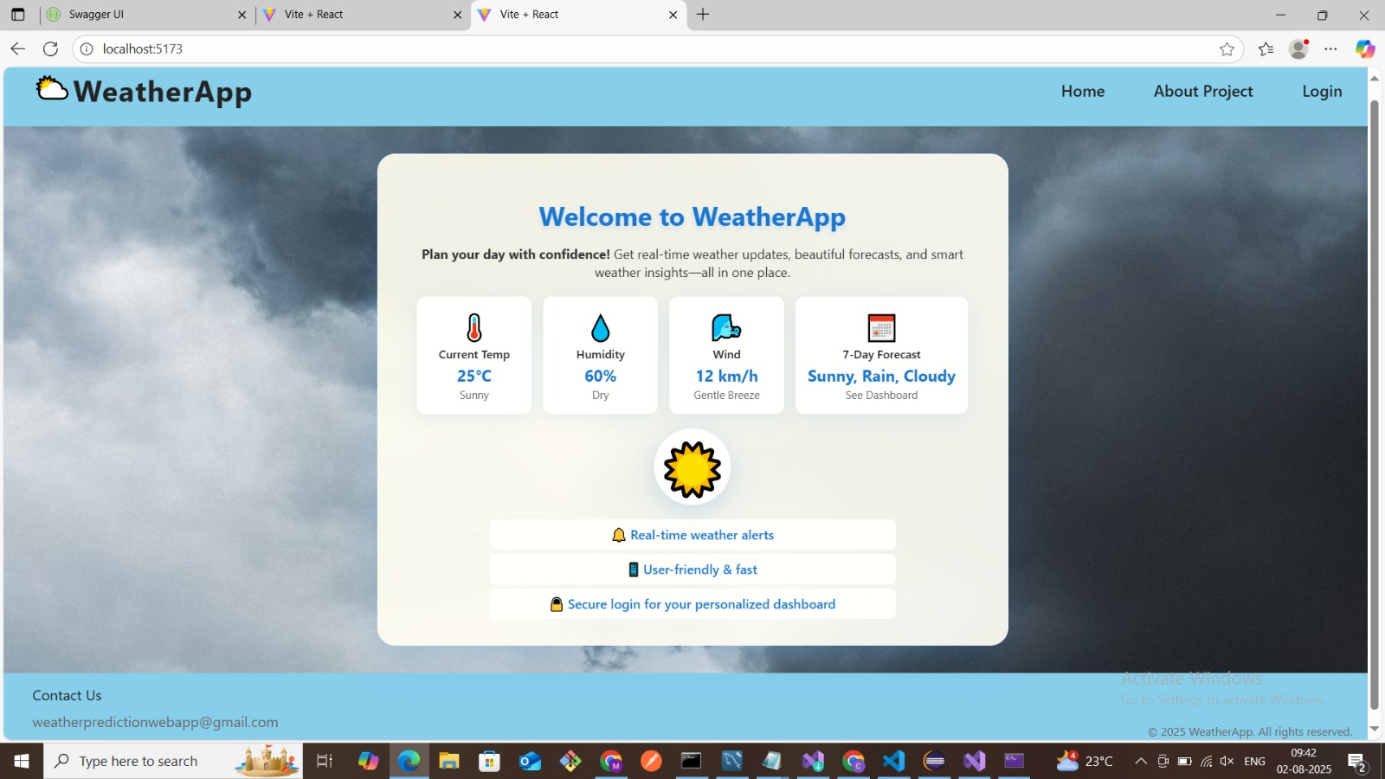

Slide 12
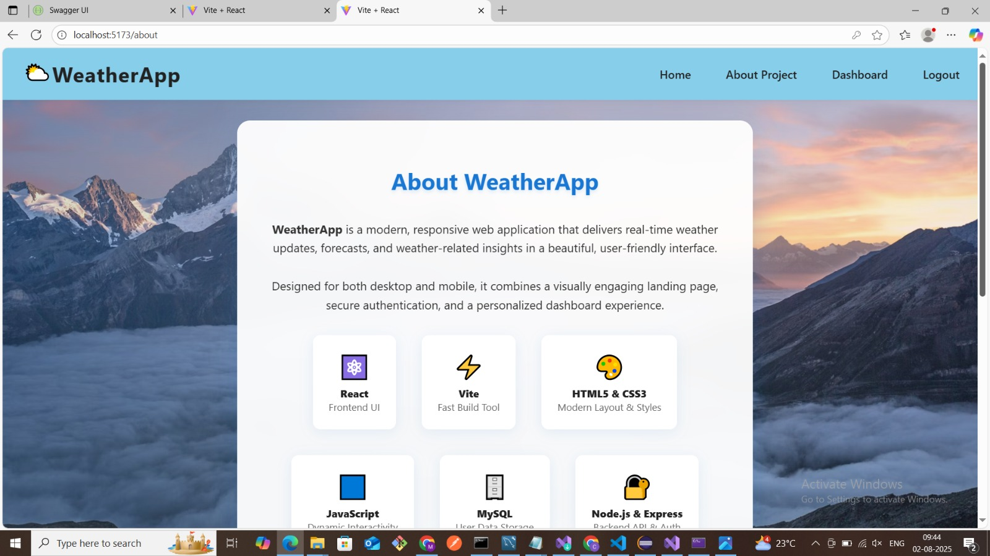

Slide 13
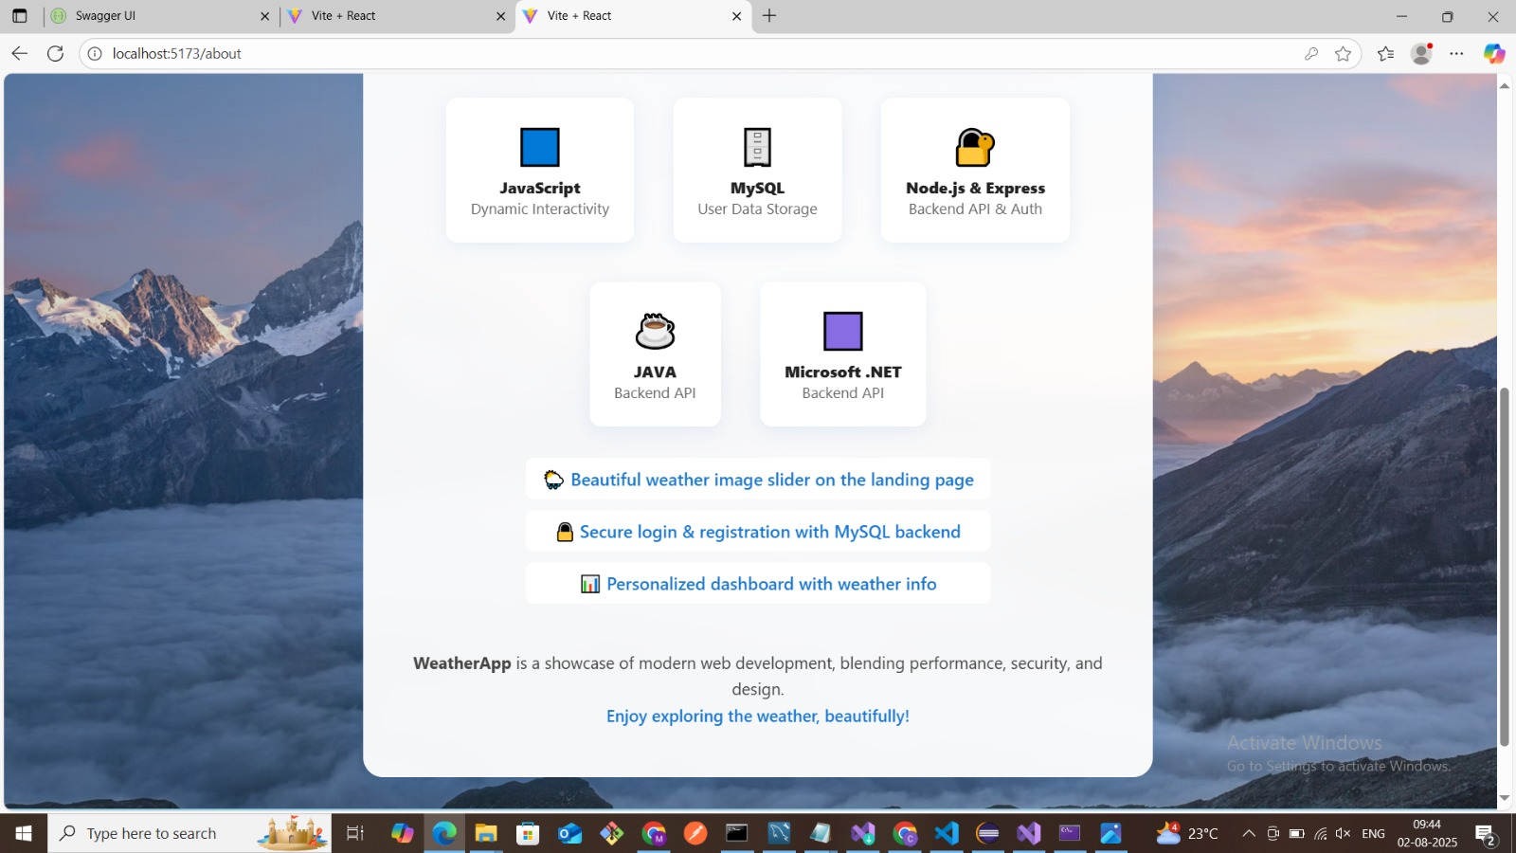

Slide 14
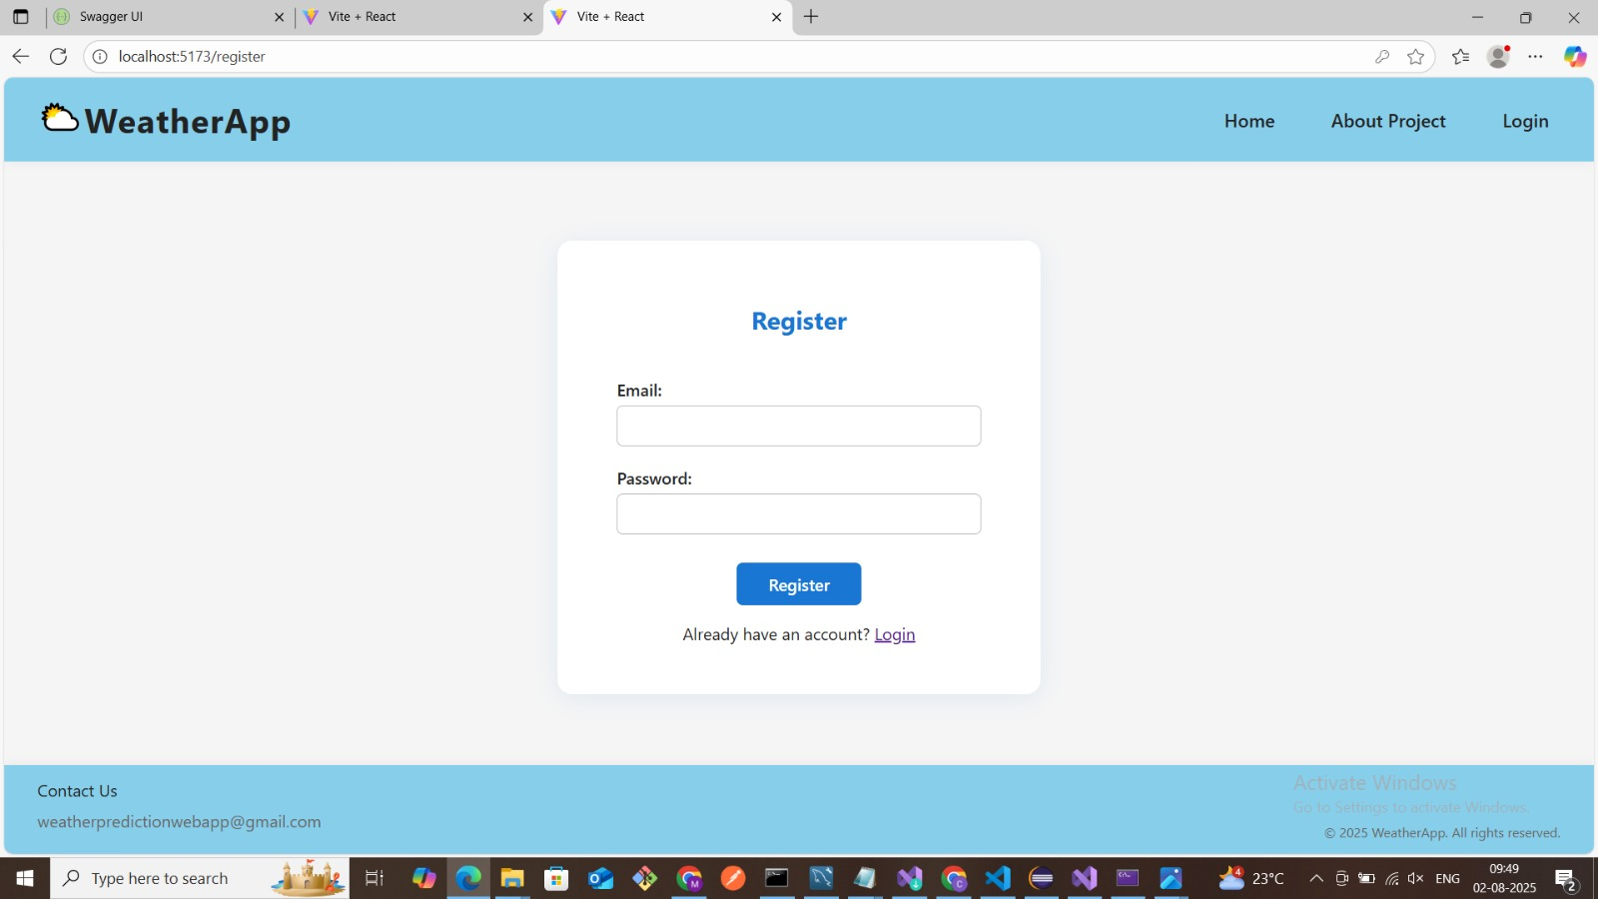

Slide 15


Slide 16
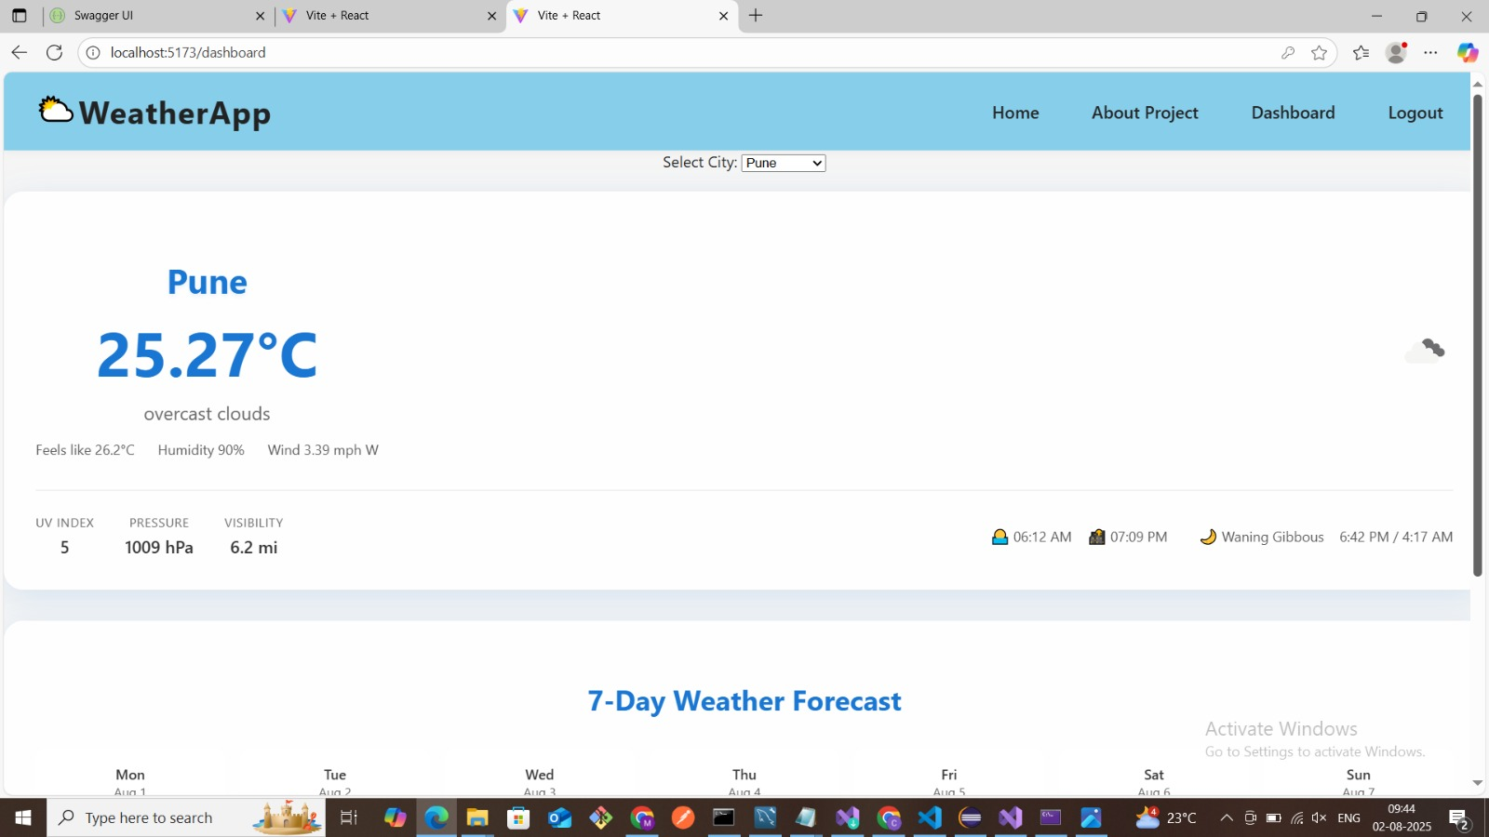

Slide 17
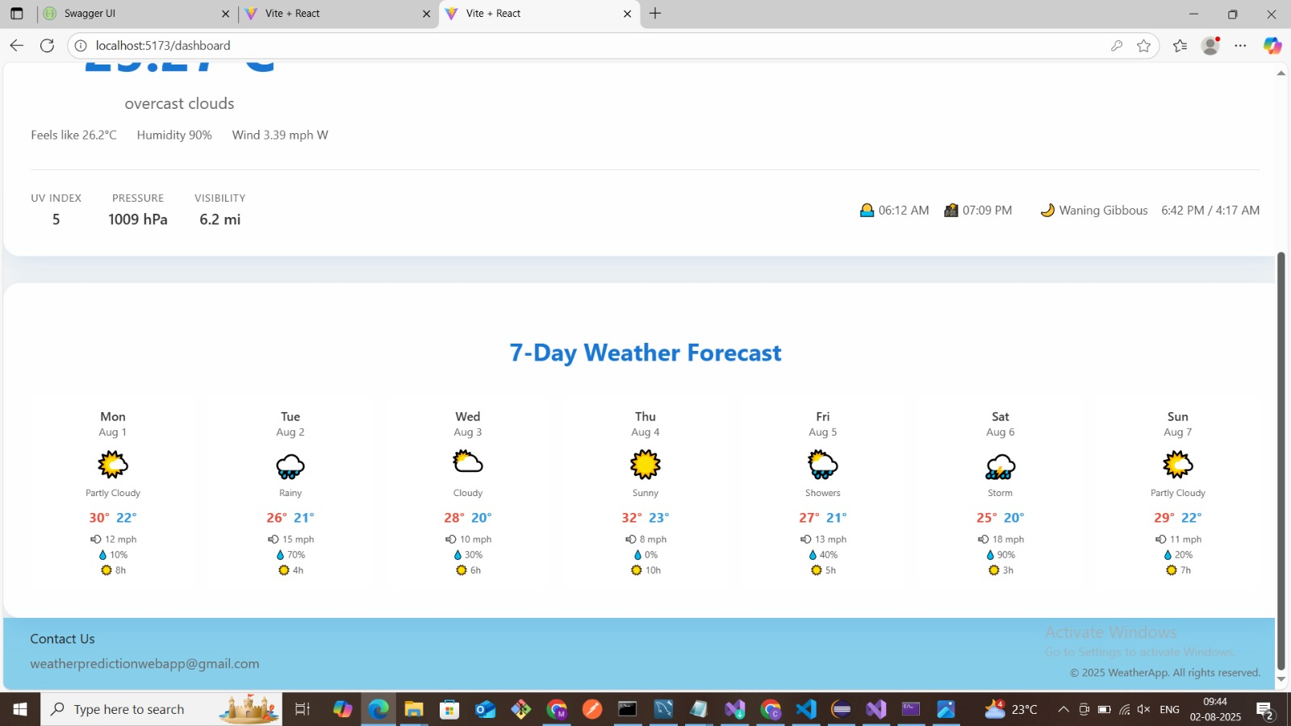

Slide 18
THANK YOU

